Slide 1
SUBMITTED BY -THILAK-
MARKETING AND RETAIL ANALYTICS – MILESTONE - 1
Post Graduate Diploma in Data Science and Business Analytics – AUG 2021

Slide 2
Table of content
03
Problem statement
EDA – Sales Across Ctrg.
17-22
04
Aim of Project
EDA – Inference & Recmd.
23
05
Data Dictionary
RFM – Customer segment
24-25
06-07
About Data
RFM – Workflow Image
26
08
Assumption of the Data
RFM – Output table head
27
09-12
EDA - Univariate
RFM – Clusters
28
13
EDA – Bi-variate
RFM – Best Customer
29
14
EDA – Multi-variate
RFM – Churn Customer
30
15-16
EDA – Trend Analysis
RFM – Loyal Customer
31
RFM – Lost Customer
32

Slide 3
Problem Statement
An automobile parts manufacturing company has collected data of transactions for 3 years. They do not have any in-house data science team, thus they have hired you as their consultant. Your job is to use your magical data science skills to provide them with suitable insights about their data and their customers.

Slide 4
Aim of the project
This project aims to find the underlying buying patterns of the customers of an automobile part manufacturer based on the past 3 years of the Company's transaction data and hence recommend customized marketing strategies for different segments of customers.

Slide 5
Data Dictionary
ORDERNUMBER : | Order Number | CUSTOMERNAME : | customer
QUANTITYORDERED : | Quantity ordered | PHONE : | Phone of the customer
PRICEEACH : | Price of Each item | ADDRESSLINE1 : | Address of customer
ORDERLINENUMBER : | order line | CITY : | City of customer
SALES : | Sales amount | POSTALCODE : | Postal Code of customer
ORDERDATE : | Order Date | COUNTRY : | Country customer
DAYS_SINCE_LASTORDER : | Days_ Since_Lastorder | CONTACTLASTNAME : | Contact person customer
STATUS : | Status of order like Shipped or not | CONTACTFIRSTNAME : | Contact person customer
PRODUCTLINE : | Product line – CATEGORY | DEALSIZE : | Size of the deal based on Quantity and Item Price
MSRP : | Manufacturer's Suggested Retail Price
PRODUCTCODE : | Code of Product

Slide 6
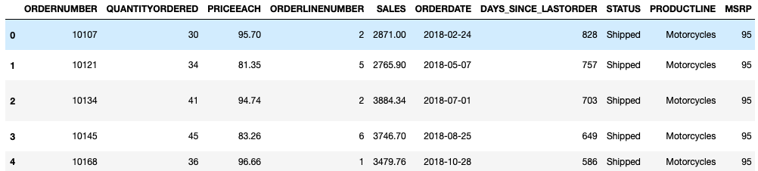
About Data
Preview of the Data
Shape of the Data:
No. of rows : 2747
No. of columns : 20

Slide 7
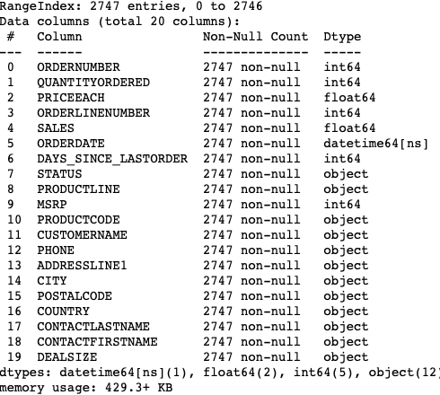
About Data
Info of the Data
Shape of data set:
2747 Rows, 20 columns
Number of variables:
6 – Numeric Variables,
1 – datetime,
12 – Categorical Variables
Null Values:
0 null values
Most of the columns: are in OBJECT data type.
One column ORDERDATE is in date time format. Rest all are in integer or float

Slide 8
Assumptions of the Data
DAYS_SINCE_LASTORDER:
Has not been taken into consideration for analysis, since, the cut-off day has not been provided, we cannot make an assumption.
We can drop the column if we need, since there is no analytical meaning.

Slide 9
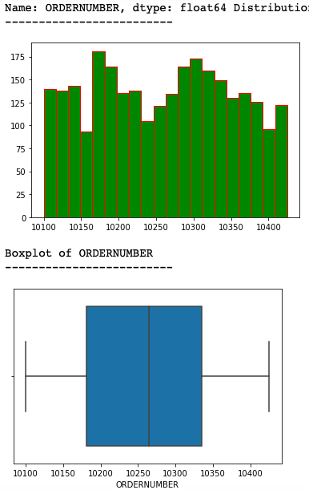
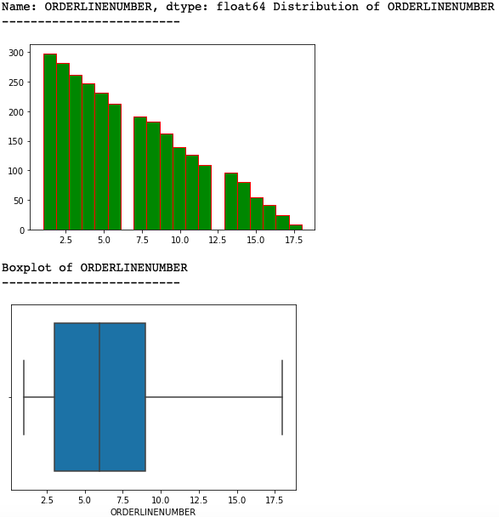
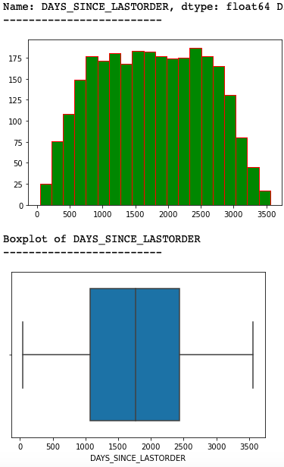
EDA
Univariate Analysis

Slide 10
Inference
Days since last ordered:
The days since last ordered represents frequency of when the customer places next order –
We can be seen most of the customers have a range of 800-2800 days of last orders.

Slide 11
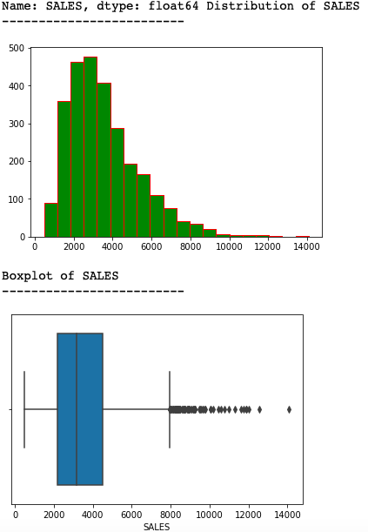
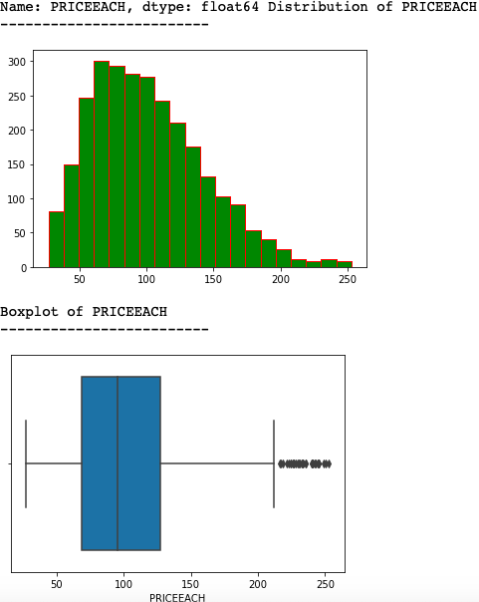
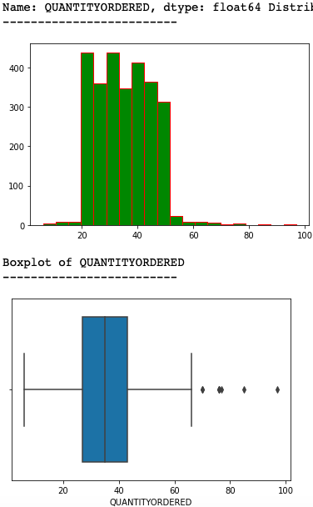
EDA

Slide 12
Inference
Price each:
The distribution of Price each is Right Skewed with max price of 252$. Interestingly, many of the orders received with the max price of above 150$.
Quantity ordered:
The distribution of quantity ordered, we can infer that most of the orders are bulk orders; Majority of the order’s quantity are between 20 -40 units.
Quantity ordered is having very high or very low values.

Slide 13
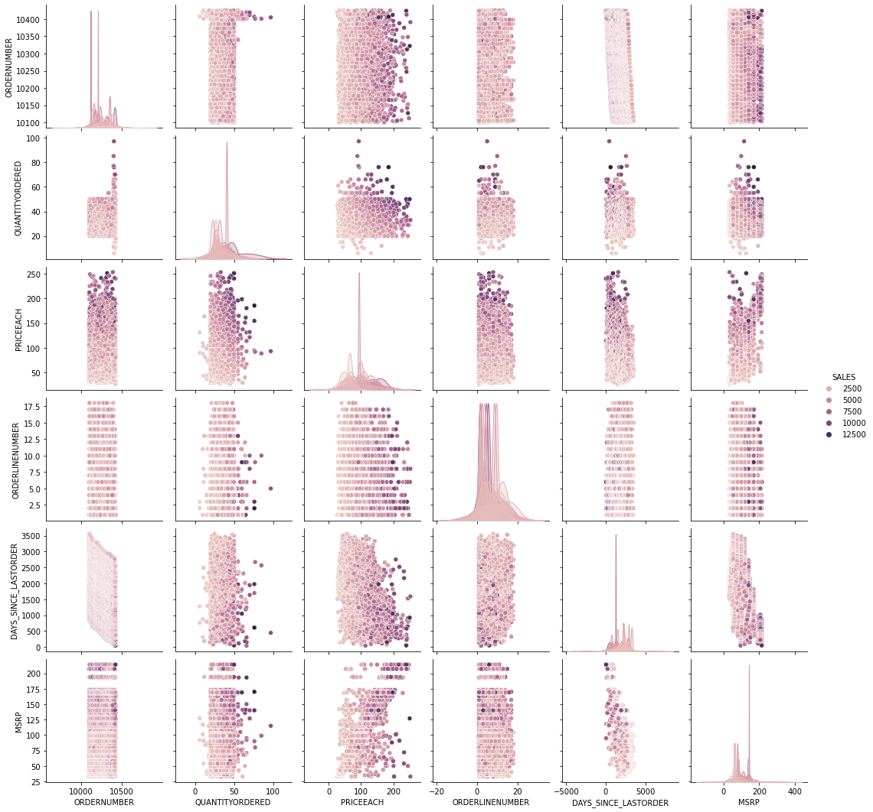
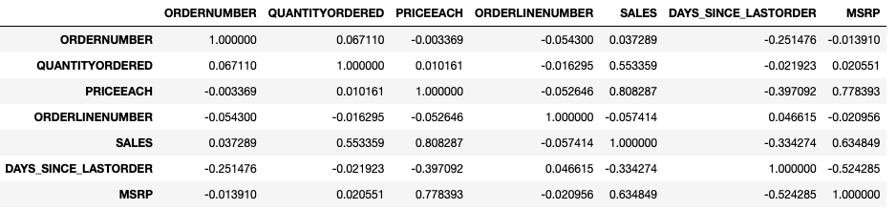
EDA
Bi-variate Analysis

Slide 14
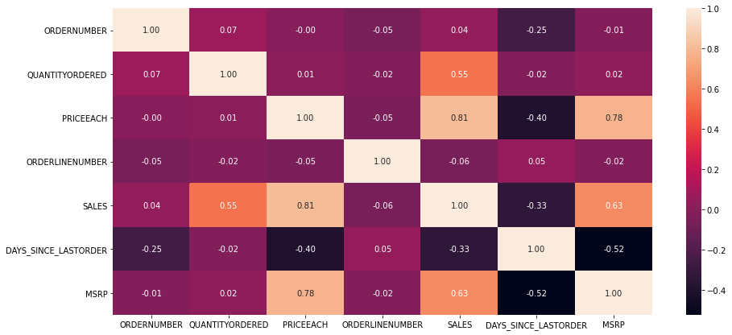
EDA
Multi-Variate Analysis
PRICEEACH is highly correlated with MSRP.
SALES is highly correlated to PRICE
Followed by, SALES is correlated to MSRP

Slide 15
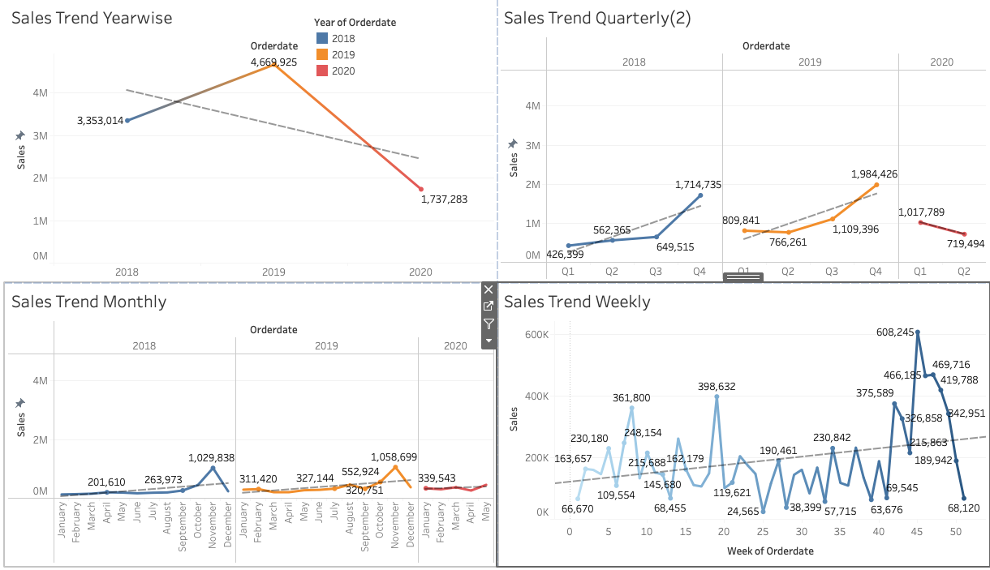
Trend Analysis

Slide 16
Insights
As per the different Sales trends
We can see that:
In Yearly trend; sales decreasing in 2020
Whereas, from 2018 with 2019 sales getting high.
In Quarterly & Monthly sales, both having increasing trend with seasonality – based on occasions

Slide 17
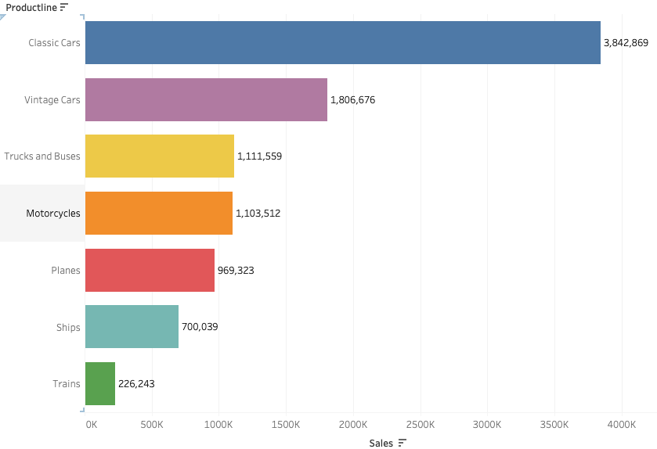
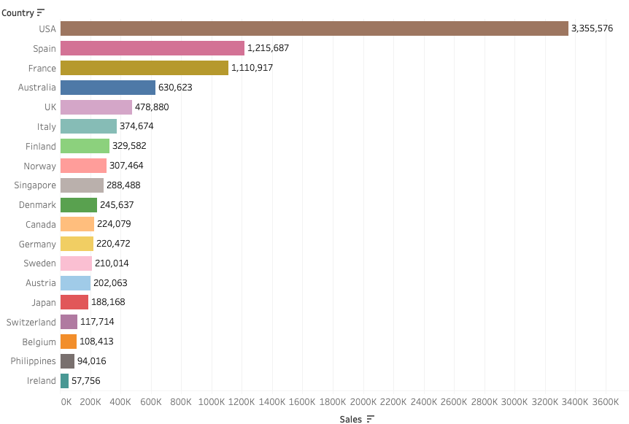
EDA – SALES ACROSS CATG.
Sales by Product
Sales by Country

Slide 18
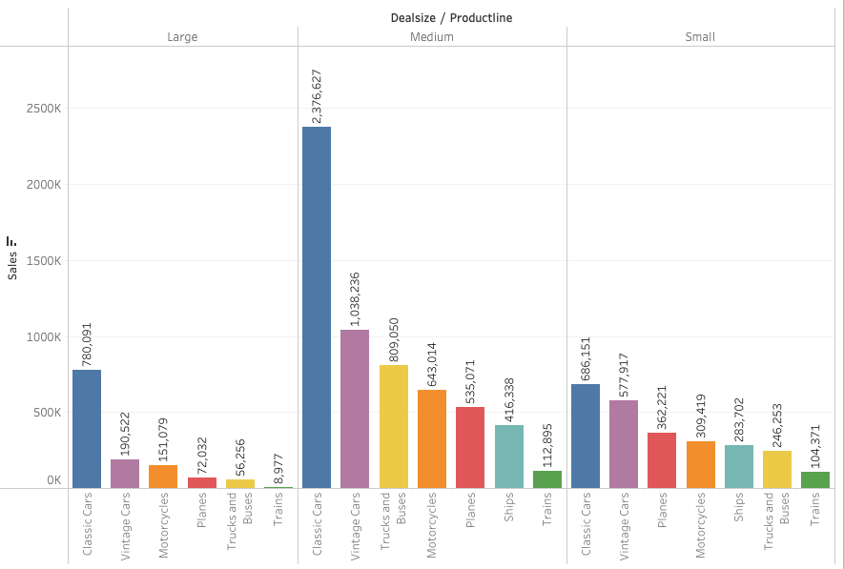
EDA – SALES ACROSS CATG.
Deal Size Vs Product category

Slide 19
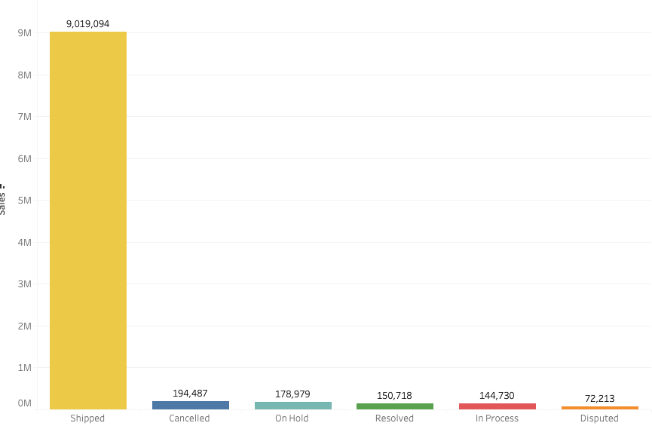
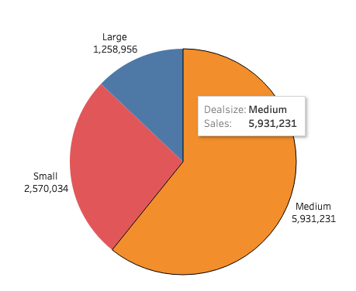
EDA – SALES ACROSS CATG.
Sales Vs Order Status ﻿
Deal Size Vs Sales

Slide 20
Inference – Sales across catg.
Deal size:
Medium and small deal generates high volume of sales compared to large deals.
Country:
USA has order more shipment followed by SPAIN, FRANCE and AUSTRALIA.
The county with least or lowest sales is IRELAND.
Product line:
CLASSIC and VINTAGE car are the hight volume of ordered qty, which generates high sales margin, whereas the least sales margin is TRAIN
Status:
We can spot that Most of the sales revenues is from shipped orders.

Slide 21
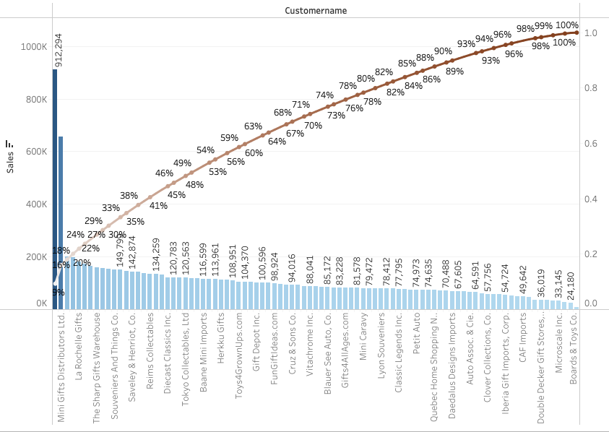
EDA – SALES ACROSS CATG.
Bi-variate Analysis -- ﻿Sales vs Customer purchases (cumulative)
Customers like:
Euro Shopping Channel & Mini Gifts Distributors Ltd. Were the top 2 customer who procured more sales.
50% of total sales volume were actually made by top 10 customers.

Slide 22
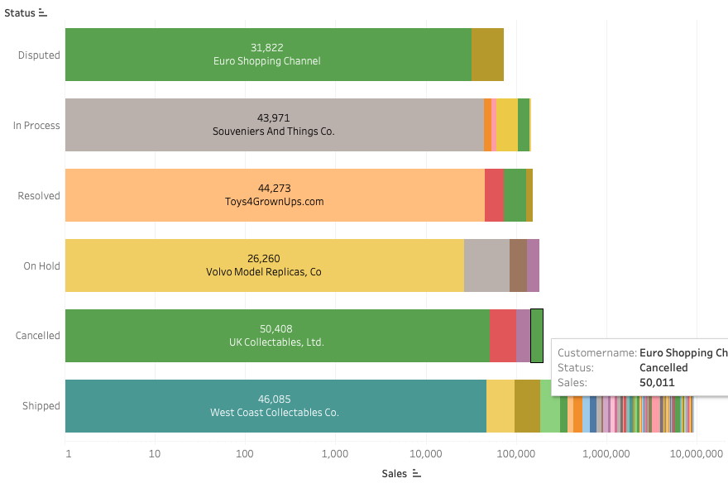
EDA – SALES ACROSS CATG.
Sales vs Status
Though Euro Shopping
channel having highest sales; some orders are in
Cancelled & Disputed status.
-- company needs to check if
this could be possible.?

Slide 23
Inference & Recomendation
The large size deals are very less in number, some action need to be taken to promote and attract the customers to buy more in large size deals.
Classic cars have the majority of sales; whereas, trains, trucks and buses sales can be expanded by providing mega offers with low EMI facilities, which can help to increase the sales.
From the trends analysis; we come to know that the sales are maximum during the 4th quarter,
By providing offers or discounts to customers, we can increase over all sales across all the quarters.
Pending disputed orders should be resolved at the earliest, so it will not add any negative feel to the customer.
cancelled orders need to be investigate

Slide 24
Customer Segmentation using RFM analysis
KNINE tool is used For Customer Segmentation using RFM Analysis.
R- Recency := Cut-off date for computing Recency is 24st May 2022
RECENCY in Days = ORDERDATE – cut-off Date
F : Frequency – How often the orders are placed by customers,
since, the cut-off day has not been provided, we cannot make an assumption, so we used ORDERNUMBER for Frequency
M : Monetory – Sales was used as Monetory
Assumptions
1 – All the prices & sales figure are in same currency.
2 – Sales & (Quantity * Price) will be same.

Slide 25
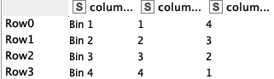
RMF SEGMENTATION
RMF has been segmented accordingly to Bins.
Created 4 Bins each for R, F & M with below distribution of values:
Top 25 %ile – Bin 1
Between 25 %ile to 50 %ile – Bin 2
Between 50 %ile to 75 %ile – Bin 3
Above 75 %ile– Bin 4

Slide 26
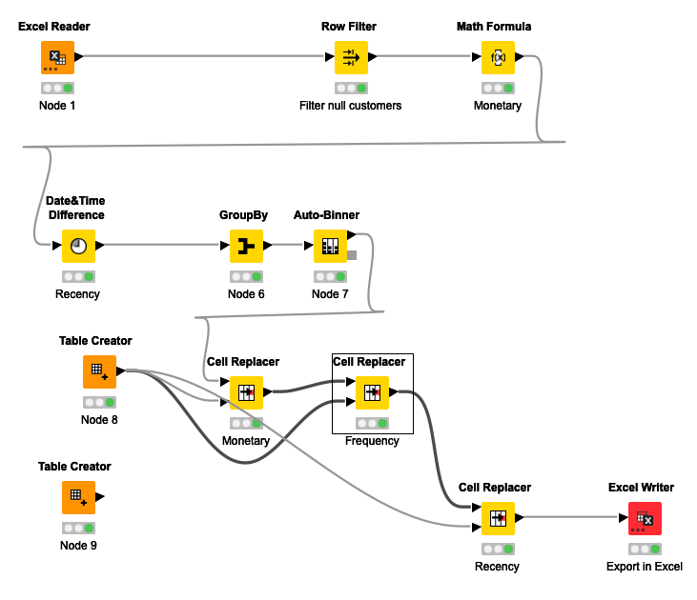
Workflow image

Slide 27
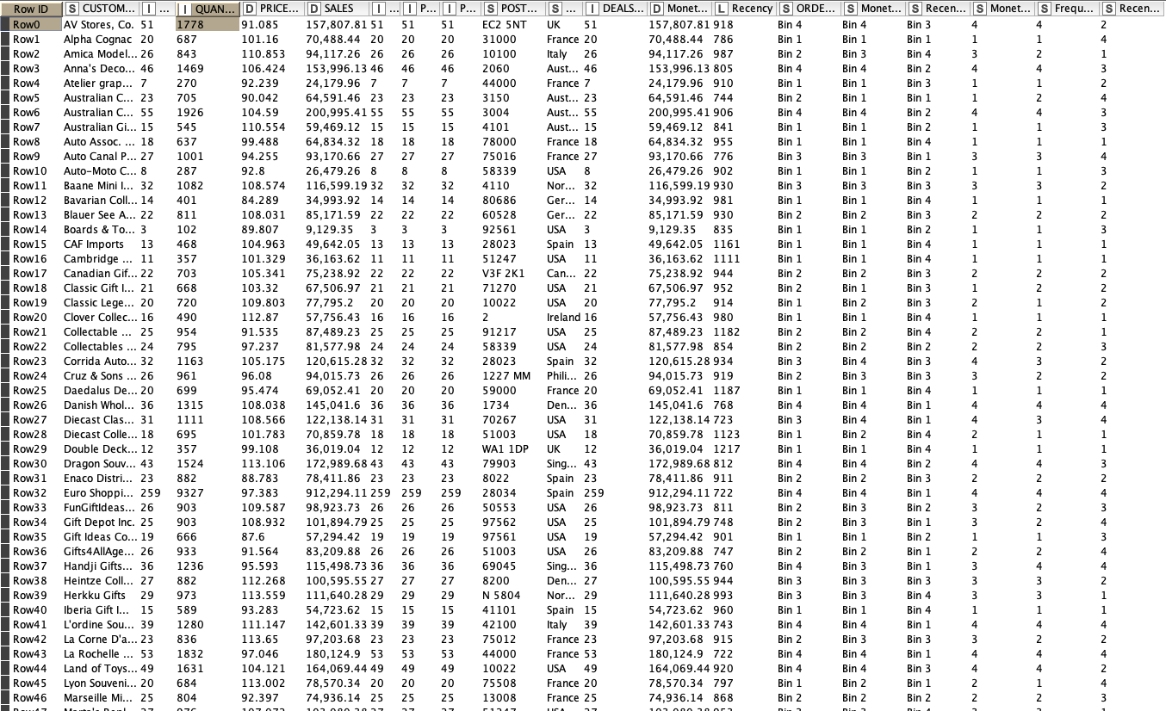
Output Table Head

Slide 28
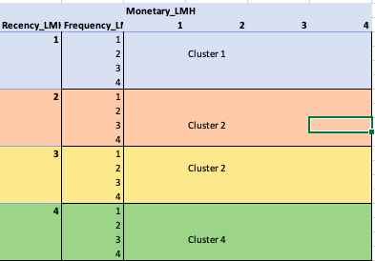
Using the output excel file from KNIME, RFM was clustered using Pivot table
RMF CLUSTERS
Cluster 1: Best Customers
Very Active customers with high orders & Sales values.
Cluster 2: Loyal Customers
Medium Value customers , who have purchased multiple times with good monetary value.
Cluster 3: Verge of churn out customers;
At risk customers with good orders & Sales values
Cluster 4: Lost customer
Customer who have provided high revenues with one time

Slide 29
Best Customers
Recency was given most significant important to select the Best customers;
Hence we have kept RECENCY as our first parameter for selecting top customers, with MONETARY and FREQUENCY (444)
Below is the list of top 5 best customers based on sales:
Euro Shopping Channel
Mini Gifts Distributors Ltd.
La Rochelle Gifts
Souveniers And Things Co.
Reims Collectables

Slide 30
Verge of Churning Customers
Customers RECENCY value is very low
Hence we have kept RECENCY as our first parameter for selecting churning customers, with MONETARY and FREQUENCY ({1,2}44)
Below is the list of top 5 Churning customers based on sales:
AV Stores, Co.
Land of Toys Inc..
Rovelli Gifts
Saveley & Henriot, Co..
Online Diecast Creations Co

Slide 31
Loyal Customers
Customers RECENCY value is Moderately low
Hence we have kept RECENCY as our first parameter for selecting churning customers, with MONETARY and FREQUENCY ({3,4}44)
Below is the list of top 5 Loyal customers based on sales:
Euro Shopping Channel.
Mini Gifts Distributors Ltd.
Australian Collectors, Co.
La Rochelle Gifts.
Muscle Machine Inc
Insights:
These customers have purchased multiple times with good monetary value. If we focus this customers, we can easily turn them into out top best customers.

Slide 32
Lost Customers
Customers RECENCY value is Very very low along with MONETARY and FREQUENCY (1,1,1)
Below is the list of top 5 lost customers based on sales:
Cambridge Collectables Co.
Double Decker Gift Stores, Ltd.
CAF Imports
West Coast Collectables Co.
Bavarian Collectables Imports, Co
Insights
We can collect feedback from these customers and try to bring them back to been a good customer.

Slide 33
Tableau Link
https://public.tableau.com/app/profile/thilak5189/viz/MRA-Project-Milestone-1EDATrend/SalesbyCountry?publish=yes
RMA output
Thank You!.

